Slide 1

CSE4227 Digital Image Processing
Chapter 10 – Image Segmentation Part II (Region based)
Dr. Kazi A Kalpoma
Professor, Department of CSE
& Director of ICT
Ahsanullah University of Science & Technology (AUST)
Contact: kalpoma@aust.com
CSE | AUST
Fall 2022

Slide 2
Today’s Contents
Region Based Segmentation
What is a Region
Region Growing, and
Region Splitting & Merging
Thresholding Based Segmentation
GLOBAL
ADAPTIVE
LOCAL
Chapter 10 from R.C. Gonzalez and R.E. Woods, Digital Image Processing (3rd Edition), Prentice Hall, 2008 [ Section 10.1, 10.2 (excluding 10.2.7) ]
Notes:
*
2
kalpoma@gmail.com

Slide 3
Segmentation Algorithms
Segmentation can be performed based on one of the following two basic properties of intensity values:
Similarity
Partitioning an image into regions that are similar according to a set of predefines criteria.
Discontinuity
Detecting boundaries of regions based on local discontinuity in intensity.

Slide 4
Region based segmentation
In edge detection we segment an image by identifying the boundaries of the objects.
These boundaries are the locations where the intensity is changed.
In the region based segmentation approach, we will identify regions occupied by the objects.
We will group pixels which are similar in some region property.
Notes:
4

Slide 5
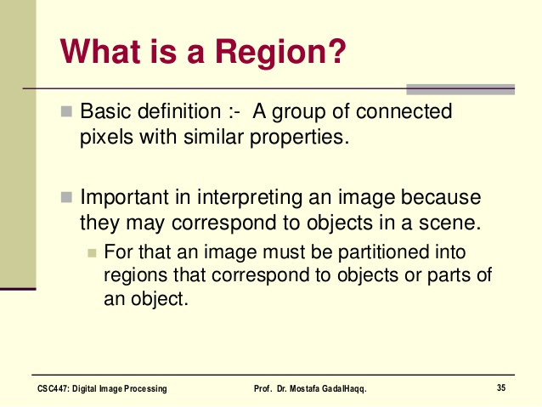

Slide 6
Edge Pixels
20 | 0 | 0 | 0 | 0 | 0 | 0 | 0
20 | 0 | 0 | 0 | 0 | 0 | 0 | 0
20 | 0 | 143 | 143 | 143 | 143 | 0 | 0
20 | 0 | 143 | 200 | 200 | 143 | 0 | 0
20 | 0 | 143 | 200 | 200 | 143 | 0 | 0
20 | 0 | 143 | 143 | 143 | 143 | 0 | 0
20 | 0 | 0 | 0 | 0 | 0 | 0 | 0
20 | 0 | 0 | 0 | 0 | 0 | 0 | 0
8x8 cropped Image

Slide 7
Edge based vs Region based Segmentation
20 | 0 | 0 | 0 | 0 | 0 | 10 | 10
20 | 0 | 0 | 0 | 0 | 0 | 10 | 10
20 | 0 | 143 | 143 | 143 | 143 | 10 | 10
20 | 0 | 143 | 200 | 200 | 143 | 10 | 10
20 | 0 | 143 | 200 | 200 | 143 | 10 | 10
20 | 0 | 143 | 143 | 143 | 143 | 10 | 10
20 | 0 | 0 | 0 | 0 | 0 | 10 | 10
20 | 0 | 0 | 0 | 0 | 0 | 10 | 10
8x8 cropped Image

Slide 8
Edge based vs Region based Segmentation
20 | 0 | 0 | 0 | 0 | 0 | 10 | 10
20 | 0 | 0 | 0 | 0 | 0 | 10 | 10
20 | 0 | 143 | 143 | 143 | 143 | 10 | 10
20 | 0 | 143 | 200 | 200 | 143 | 10 | 10
20 | 0 | 143 | 200 | 200 | 143 | 10 | 10
20 | 0 | 143 | 143 | 143 | 143 | 10 | 10
20 | 0 | 0 | 0 | 0 | 0 | 10 | 10
20 | 0 | 0 | 0 | 0 | 0 | 10 | 10
Notes:
8

Slide 9
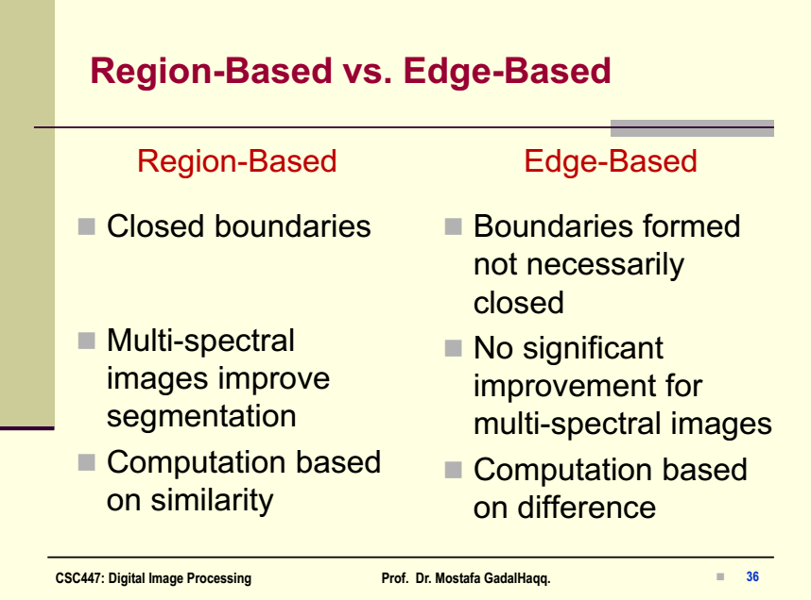

Slide 10
Region Based Segmentation Method
Segments the image into various regions having similar characteristics.
The two basic techniques based on this method are:
i) Region Growing, and
ii) Region Splitting & Merging.

Slide 11
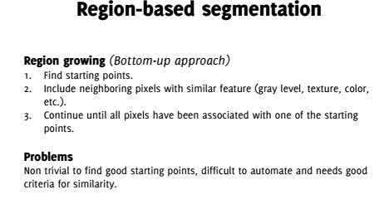

Slide 12
Region Growing
Region growing techniques start with one pixel of a
potential region and try to grow it by adding adjacent
pixels till the pixels being compared are too disimilar.
The first pixel selection can be just the first unlabeled
pixel in the image or a set of seed pixels can be chosen
from the image.
Usually a statistical test is used to decide which pixels
can be added to a region.
12

Slide 13
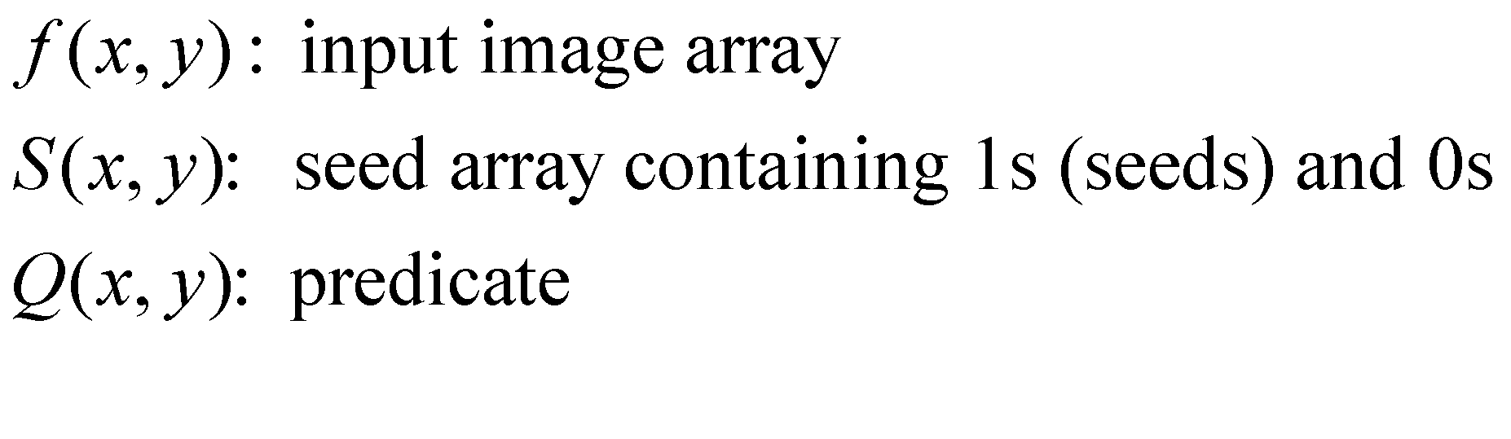
Region-Based Segmentation
Example: Region Growing based on 8-connectivity

Slide 14
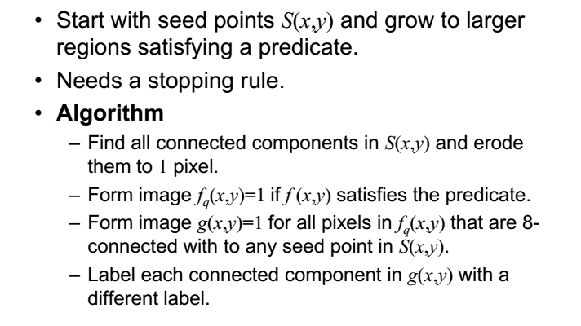
Region Growing Algorithm
*
14

Slide 15
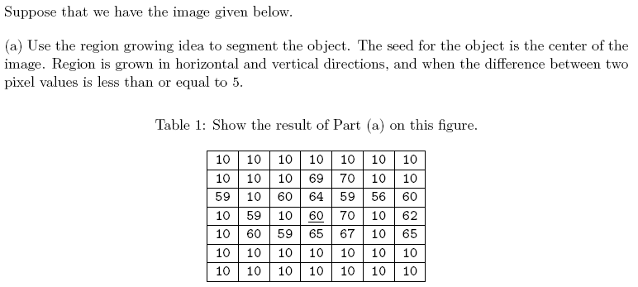
Example

Slide 16
Example
4-connectivity
T <= 5

Slide 17
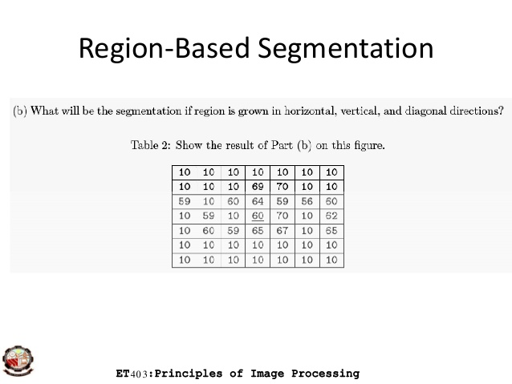
Example

Slide 18
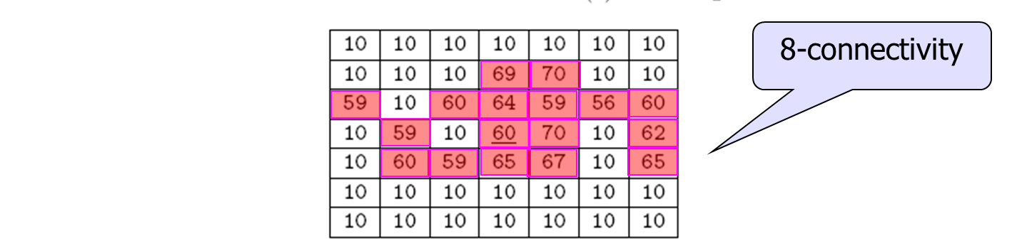
Example

Slide 19
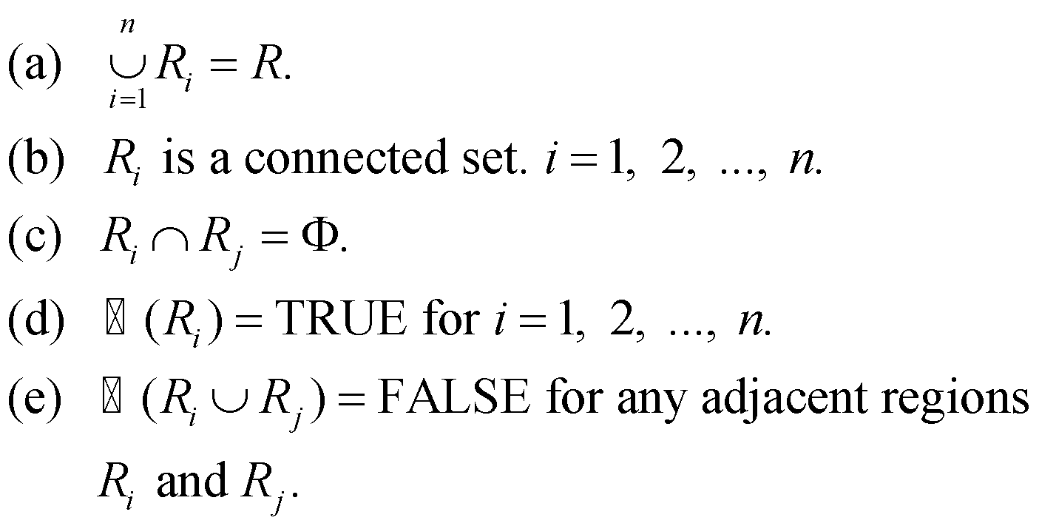
Region Splitting and Merging
Let R represent the entire spatial region occupied by an image. Image segmentation is a process that partitions R into n sub-regions, R₁, R₂, …, R_{n}, such that
Logical predicate

Slide 20

Region-Based Segmentation
Region Splitting
Region Growing: Starts from a set of seed points.
Region Splitting: Starts with the whole image as a single region and subdivide the regions that do not satisfy a condition.
Image = One Region R
Select a predicate P (gray values etc.)
Successively divide each region into smaller and smaller quadrant regions so that:
*
Image Segmentation
20

Slide 21
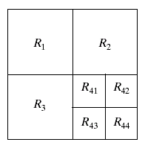
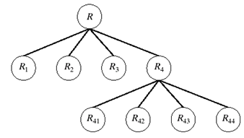
Region-Based Segmentation
Region Splitting
Problem?
Adjacent regions could be same
Solution?
Allow Merge
*
Image Segmentation
21
Notes:
21

Slide 22

Region-Based Segmentation
Region Merging
Region merging is the opposite of region splitting.
Merge adjacent regions R_{i} and R_{j} for which:
Region Splitting/Merging
Stop when no further split or merge is possible
*
Image Segmentation
22

Slide 23
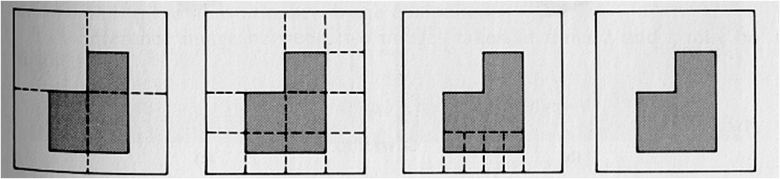
Region-Based Segmentation
Example
Split into four disjointed quadrants any region R_{i} where P(R_{i})=False
Merge any adjacent regions R_{j} and R_{k} for which P(R_{j} U R_{k})=True
Stop when no further merging or splitting is possible
*
Image Segmentation
23

Slide 24
Region Splitting Example
Select a threshold first…say T <= 4.
5 | 6 | 6 | 6 | 7 | 7 | 6 | 6
6 | 7 | 6 | 7 | 5 | 5 | 4 | 7
6 | 6 | 4 | 4 | 3 | 2 | 5 | 6
5 | 4 | 5 | 4 | 2 | 3 | 4 | 6
0 | 3 | 2 | 3 | 3 | 2 | 4 | 7
0 | 0 | 0 | 0 | 2 | 2 | 5 | 6
1 | 1 | 0 | 1 | 0 | 3 | 4 | 4
1 | 0 | 1 | 0 | 2 | 3 | 5 | 4
Please see the video recording to understand the example.
*
Image Segmentation
24

Slide 25
Region Splitting Example
Select a threshold first…say T <= 4.
5 | 6 | 6 | 6 | 7 | 7 | 6 | 6
6 | 7 | 6 | 7 | 5 | 5 | 4 | 7
6 | 6 | 4 | 4 | 3 | 2 | 5 | 6
5 | 4 | 5 | 4 | 2 | 3 | 4 | 6
0 | 3 | 2 | 3 | 3 | 2 | 4 | 7
0 | 0 | 0 | 0 | 2 | 2 | 5 | 6
1 | 1 | 0 | 1 | 0 | 3 | 4 | 4
1 | 0 | 1 | 0 | 2 | 3 | 5 | 4
Please see the video recording to understand the example.
*
Image Segmentation
25

Slide 26
Region Splitting Example
Select a threshold first…say T <= 4.
5 | 6 | 6 | 6 | 7 | 7 | 6 | 6
6 | 7 | 6 | 7 | 5 | 5 | 4 | 7
6 | 6 | 4 | 4 | 3 | 2 | 5 | 6
5 | 4 | 5 | 4 | 2 | 3 | 4 | 6
0 | 3 | 2 | 3 | 3 | 2 | 4 | 7
0 | 0 | 0 | 0 | 2 | 2 | 5 | 6
1 | 1 | 0 | 1 | 0 | 3 | 4 | 4
1 | 0 | 1 | 0 | 2 | 3 | 5 | 4
Please see the video recording to understand the example.
*
Image Segmentation
26

Slide 27
Region Splitting Example
Select a threshold first…say T <= 4.
5 | 6 | 6 | 6 | 7 | 7 | 6 | 6
6 | 7 | 6 | 7 | 5 | 5 | 4 | 7
6 | 6 | 4 | 4 | 3 | 2 | 5 | 6
5 | 4 | 5 | 4 | 2 | 3 | 4 | 6
0 | 3 | 2 | 3 | 3 | 2 | 4 | 7
0 | 0 | 0 | 0 | 2 | 2 | 5 | 6
1 | 1 | 0 | 1 | 0 | 3 | 4 | 4
1 | 0 | 1 | 0 | 2 | 3 | 5 | 4
Please see the video recording to understand the example.
*
Image Segmentation
27

Slide 28
Region Splitting Example
Select a threshold first…say T <= 4.
5 | 6 | 6 | 6 | 7 | 7 | 6 | 6
6 | 7 | 6 | 7 | 5 | 5 | 4 | 7
6 | 6 | 4 | 4 | 3 | 2 | 5 | 6
5 | 4 | 5 | 4 | 2 | 3 | 4 | 6
0 | 3 | 2 | 3 | 3 | 2 | 4 | 7
0 | 0 | 0 | 0 | 2 | 2 | 5 | 6
1 | 1 | 0 | 1 | 0 | 3 | 4 | 4
1 | 0 | 1 | 0 | 2 | 3 | 5 | 4
Please see the video recording to understand the example.
*
Image Segmentation
28

Slide 29
Region Splitting Example
Select a threshold first…say T <= 4.
5 | 6 | 6 | 6 | 7 | 7 | 6 | 6
6 | 7 | 6 | 7 | 5 | 5 | 4 | 7
6 | 6 | 4 | 4 | 3 | 2 | 5 | 6
5 | 4 | 5 | 4 | 2 | 3 | 4 | 6
0 | 3 | 2 | 3 | 3 | 2 | 4 | 7
0 | 0 | 0 | 0 | 2 | 2 | 5 | 6
1 | 1 | 0 | 1 | 0 | 3 | 4 | 4
1 | 0 | 1 | 0 | 2 | 3 | 5 | 4
Please see the video recording to understand the example.
*
Image Segmentation
29

Slide 30
Region Splitting Example
Select a threshold first…say T <= 4.
5 | 6 | 6 | 6 | 7 | 7 | 6 | 6
6 | 7 | 6 | 7 | 5 | 5 | 4 | 7
6 | 6 | 4 | 4 | 3 | 2 | 5 | 6
5 | 4 | 5 | 4 | 2 | 3 | 4 | 6
0 | 3 | 2 | 3 | 3 | 2 | 4 | 7
0 | 0 | 0 | 0 | 2 | 2 | 5 | 6
1 | 1 | 0 | 1 | 0 | 3 | 4 | 4
1 | 0 | 1 | 0 | 2 | 3 | 5 | 4
Please see the video recording to understand the example.
*
Image Segmentation
30

Slide 31
Region Splitting Example
Select a threshold first…say T <= 4.
5 | 6 | 6 | 6 | 7 | 7 | 6 | 6
6 | 7 | 6 | 7 | 5 | 5 | 4 | 7
6 | 6 | 4 | 4 | 3 | 2 | 5 | 6
5 | 4 | 5 | 4 | 2 | 3 | 4 | 6
0 | 3 | 2 | 3 | 3 | 2 | 4 | 7
0 | 0 | 0 | 0 | 2 | 2 | 5 | 6
1 | 1 | 0 | 1 | 0 | 3 | 4 | 4
1 | 0 | 1 | 0 | 2 | 3 | 5 | 4
Please see the video recording to understand the example.
*
Image Segmentation
31

Slide 32
Region Splitting Example
Select a threshold first…say T <= 4.
5 | 6 | 6 | 6 | 7 | 7 | 6 | 6
6 | 7 | 6 | 7 | 5 | 5 | 4 | 7
6 | 6 | 4 | 4 | 3 | 2 | 5 | 6
5 | 4 | 5 | 4 | 2 | 3 | 4 | 6
0 | 3 | 2 | 3 | 3 | 2 | 4 | 7
0 | 0 | 0 | 0 | 2 | 2 | 5 | 6
1 | 1 | 0 | 1 | 0 | 3 | 4 | 4
1 | 0 | 1 | 0 | 2 | 3 | 5 | 4
Please see the video recording to understand the example.
*
Image Segmentation
32

Slide 33
Region Splitting Example
Select a threshold first…say T <= 4.
5 | 6 | 6 | 6 | 7 | 7 | 6 | 6
6 | 7 | 6 | 7 | 5 | 5 | 4 | 7
6 | 6 | 4 | 4 | 3 | 2 | 5 | 6
5 | 4 | 5 | 4 | 2 | 3 | 4 | 6
0 | 3 | 2 | 3 | 3 | 2 | 4 | 7
0 | 0 | 0 | 0 | 2 | 2 | 5 | 6
1 | 1 | 0 | 1 | 0 | 3 | 4 | 4
1 | 0 | 1 | 0 | 2 | 3 | 5 | 4
Please see the video recording to understand the example.
*
Image Segmentation
33

Slide 34
Region Splitting Example
Select a threshold first…say T <= 4.
5 | 6 | 6 | 6 | 7 | 7 | 6 | 6
6 | 7 | 6 | 7 | 5 | 5 | 4 | 7
6 | 6 | 4 | 4 | 3 | 2 | 5 | 6
5 | 4 | 5 | 4 | 2 | 3 | 4 | 6
0 | 3 | 2 | 3 | 3 | 2 | 4 | 7
0 | 0 | 0 | 0 | 2 | 2 | 5 | 6
1 | 1 | 0 | 1 | 0 | 3 | 4 | 4
1 | 0 | 1 | 0 | 2 | 3 | 5 | 4
Please see the video recording to understand the example.
*
Image Segmentation
34

Slide 35
Region Splitting Example
Select a threshold first…say T <= 4.
5 | 6 | 6 | 6 | 7 | 7 | 6 | 6
6 | 7 | 6 | 7 | 5 | 5 | 4 | 7
6 | 6 | 4 | 4 | 3 | 2 | 5 | 6
5 | 4 | 5 | 4 | 2 | 3 | 4 | 6
0 | 3 | 2 | 3 | 3 | 2 | 4 | 7
0 | 0 | 0 | 0 | 2 | 2 | 5 | 6
1 | 1 | 0 | 1 | 0 | 3 | 4 | 4
1 | 0 | 1 | 0 | 2 | 3 | 5 | 4
Please see the video recording to understand the example.
*
Image Segmentation
35

Slide 36

https://www.youtube.com/watch?v=hKYBNdSspIo
*
Image Segmentation
36

Slide 37
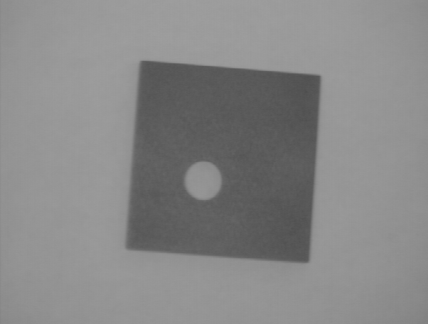


Thresholding
Segmentation into two classes/groups
Foreground (Objects)
Background
*
Image Segmentation
37

Slide 38
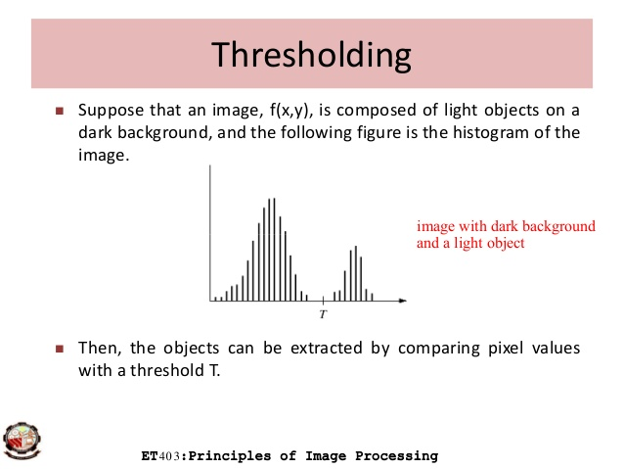
*
Image Segmentation
38

Slide 39
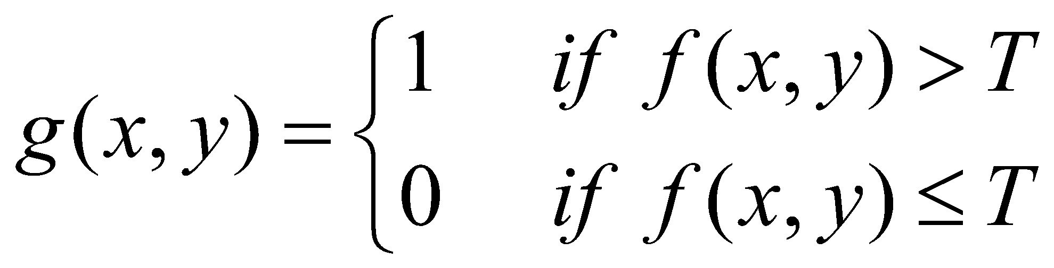
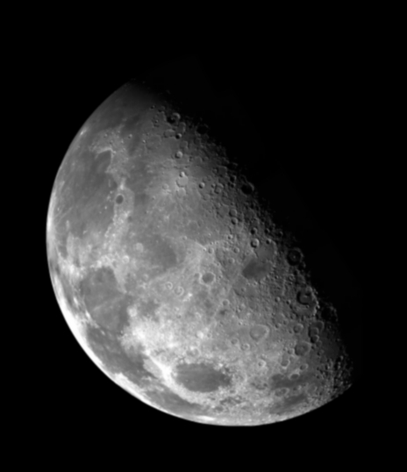

Thresholding
Objects & Background
1.0
r > threshold
s =
0.0
r <= threshold
*
Image Segmentation
39

Slide 40
Thresholding
GLOBAL
ADAPTIVE
LOCAL
*
Image Segmentation
40

Slide 41
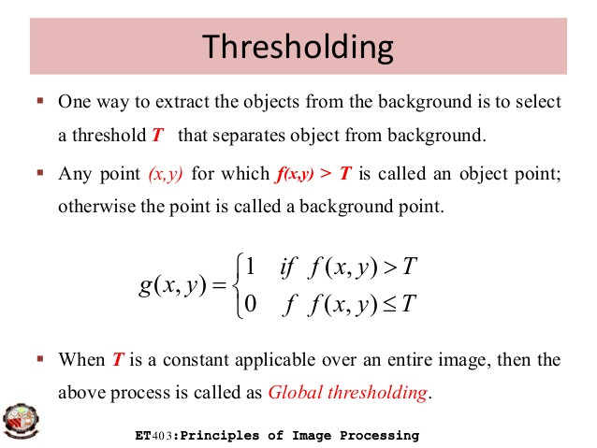
*
Image Segmentation
41

Slide 42
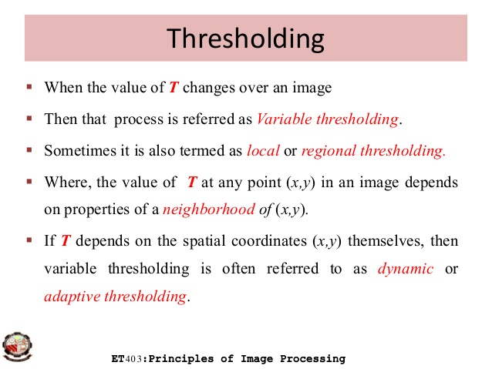
*
Image Segmentation
42

Slide 43
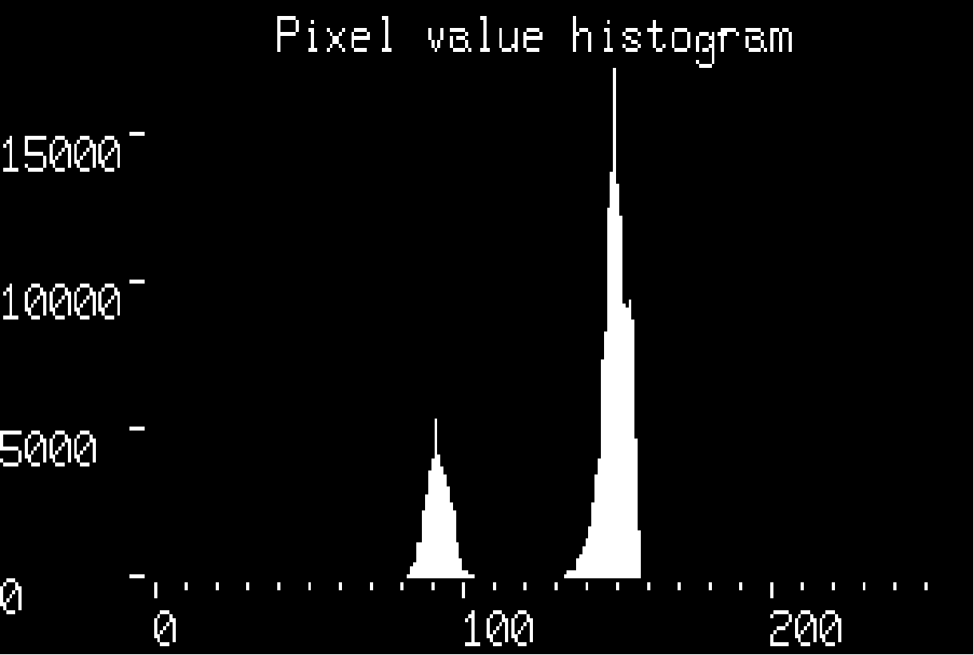
Global Thresholding
Single threshold value for entire image
Fixed ?
Automatic
Intensity histogram
*
Image Segmentation
43

Slide 44

Global Thresholding
Single threshold value for entire image
Fixed ?
Automatic
Intensity histogram
*
Image Segmentation
44

Slide 45
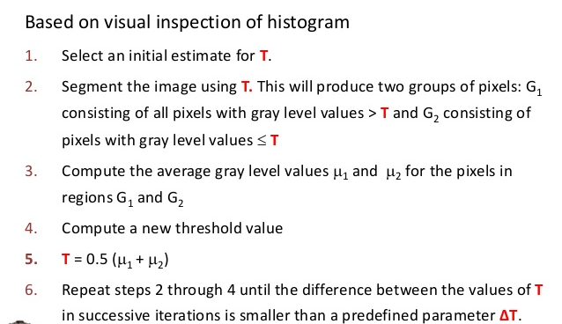
Global Thresholding
*
Image Segmentation
45

Slide 46

https://www.youtube.com/watch?v=f1SaYzOthCM
*
Image Segmentation
46

Slide 47
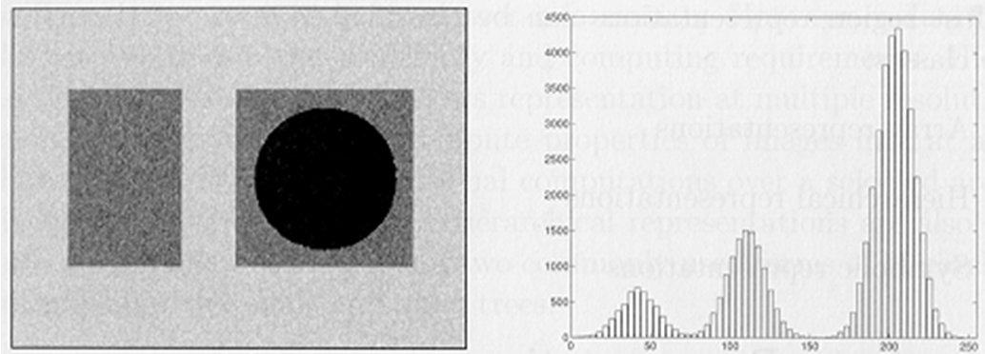
Global Thresholding?
Multilevel Thresholding can be a solution?
*
Image Segmentation
47

Slide 48
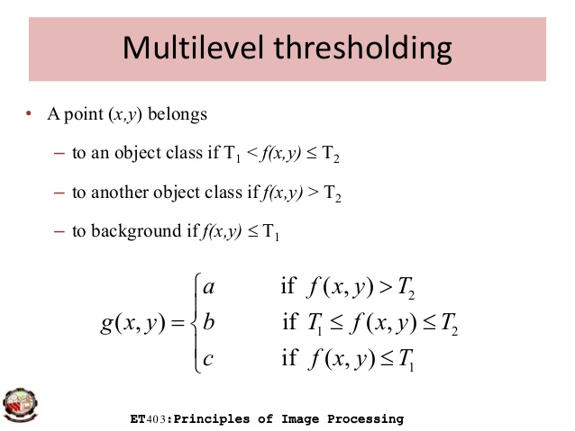
*
Image Segmentation
48

Slide 49
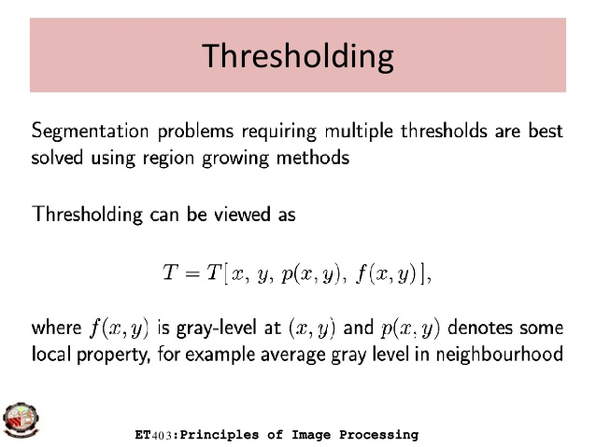
*
Image Segmentation
49

Slide 50
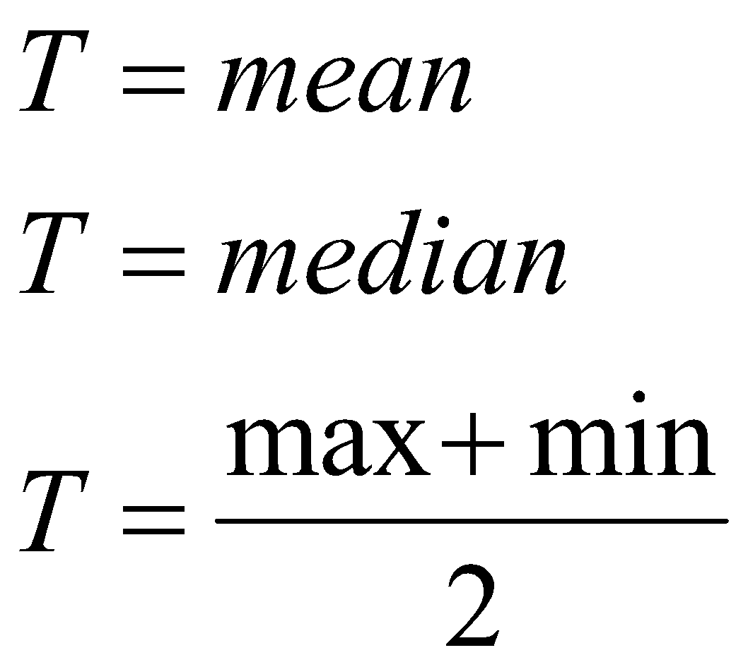
Local Adaptive Thresholding
The Local Adaptive Thresholding chooses different threshold values for every pixel in the image based on an analysis of its neighboring pixels.
Threshold: function of neighboring pixels
*
Image Segmentation
50

Slide 51
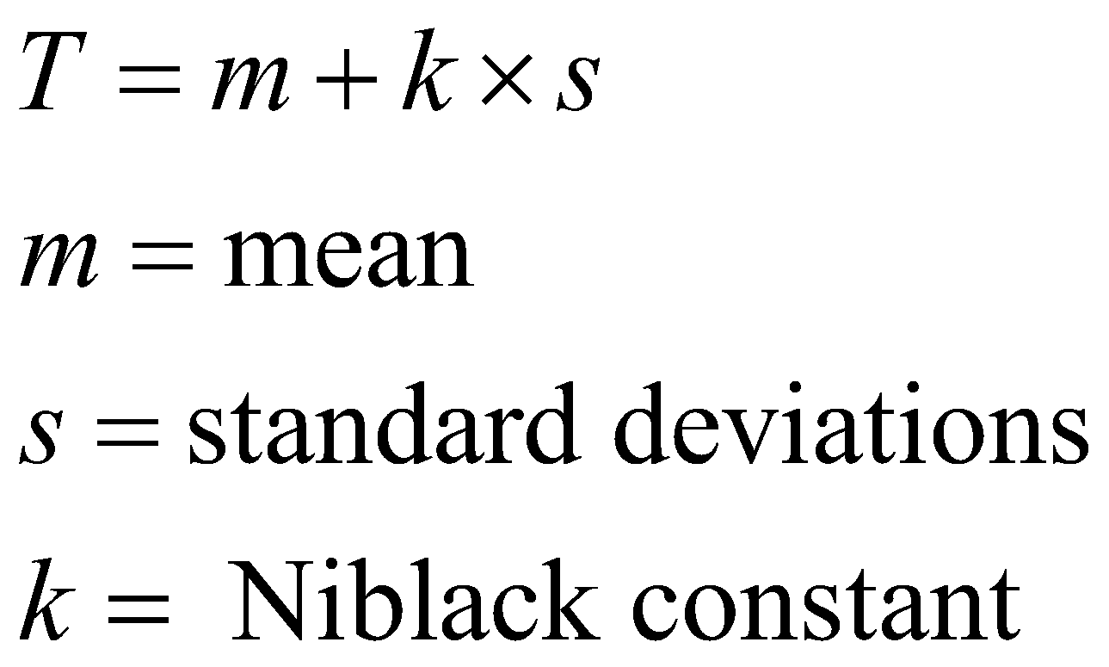
Local Adaptive Thresholding
Niblack Algorithm
Neighborhood size???
*
Image Segmentation
51

Slide 52
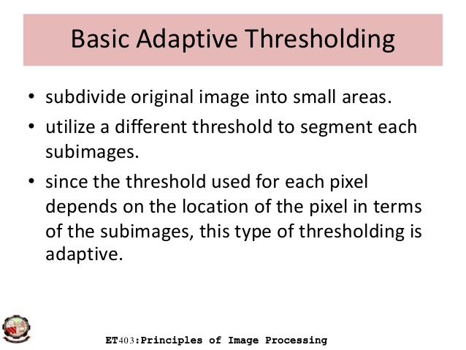
*
Image Segmentation
52

Slide 53
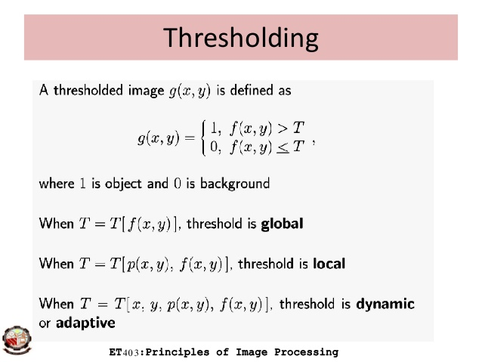
*
Image Segmentation
53

Slide 54

https://youtu.be/nPyb2BVBeB8
*
Image Segmentation
54

Slide 55
K-Means Clustering
Chose the number (K) of clusters and randomly select the centroids of each cluster.
For each data point:
Calculate the distance from the data point to each cluster.
Assign the data point to the closest cluster.
Recompute the centroid of each cluster.
Repeat steps 2 and 3 until there is no further change in the assignment of data points (or in the centroids).
*
Image Segmentation
55

Slide 56
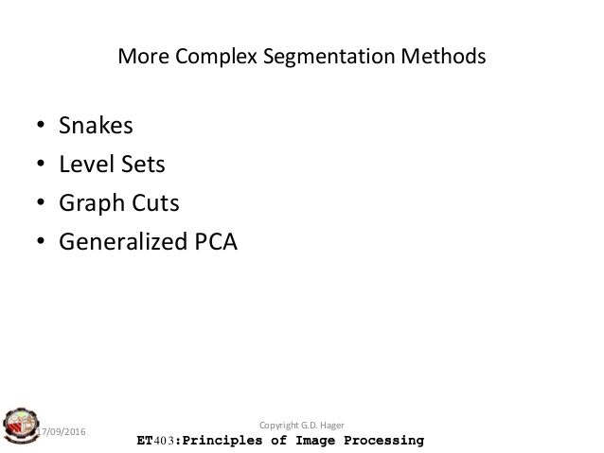
*
Image Segmentation
56

Slide 57
Review
Segmentation based on Threshold
Histogram thresholding and slicing methods are used to partition the image.
Image segmentation by thresholding is a simple but powerful approach for segmenting images having light objects on grim background
Thresholding procedure used to distribute as intensity value called as threshold, and threshold divides the desires classes.

Slide 58
Review
Segmentation based on Edge
detected edges in an image conclude to represent object boundaries.
The easiest way to observe edges in an image is to focus for places in the image where the intensity changes promptly, using one of this criterion.
Places where the first derivative of the intensity is larger in magnitude than some threshold.
Places where the second derivative of the intensity has a zero crossing.
Edges are discovered first, and then they are linked together to form forced boundaries.

Slide 59
Review
Segmentation based on Region
Where an edge based technique may try to explore the object boundaries and then discover the object itself by packing them in,
a region based method takes the opposite approach,
by (e.g.) beginning in the inside of an object and then “growing” outward until it encounter the object boundaries.

Slide 60
Review
Clustering Techniques
Clustering techniques try to batch together patterns that are alike in unspecified sense.
Matching
Depending on the looks of the object that we are trying to identify in an image, we can use this knowledge to locate the object in an image.
This attitude to segmentation is called matching.

